Slide 1
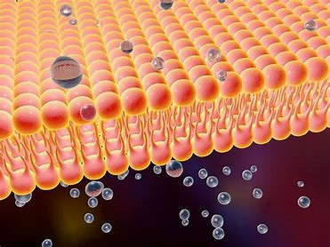
Exchange across membranes
AEHBY ATAR Human Biology

Slide 2
Review
Draw the fluid mosaic model.
Distinguish between active and passive transport.
Distinguish between channel proteins and carrier proteins.
Distinguish between simple diffusion and facilitated diffusion.
Compare and contrast pinocytosis and phagocytosis.
List the functions of the cell membrane.

Slide 3
Type of transport | Passive or active | Substances transported
Simple diffusion
Simple diffusion
Osmosis
Facilitated transport
Facilitated diffusion
Active transport
Vesicular transport
Endocytosis
Exocytosis

Slide 4
Learning Intentions
Factors affecting the exchange of materials across the cell membrane include surface area to volume ratio, concentration gradients, and the physical and chemical nature of the materials being exchanged

Slide 5
Success Criteria
Define concentration gradient
List factors affecting exchange across membranes
Give examples of substances transported by simple diffusion, facilitated diffusion, osmosis, active transport and vesicular transport

Slide 6
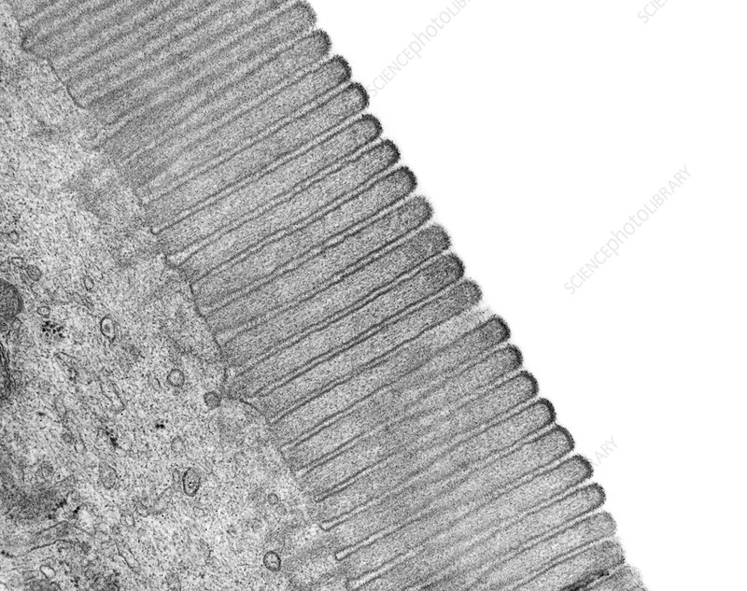
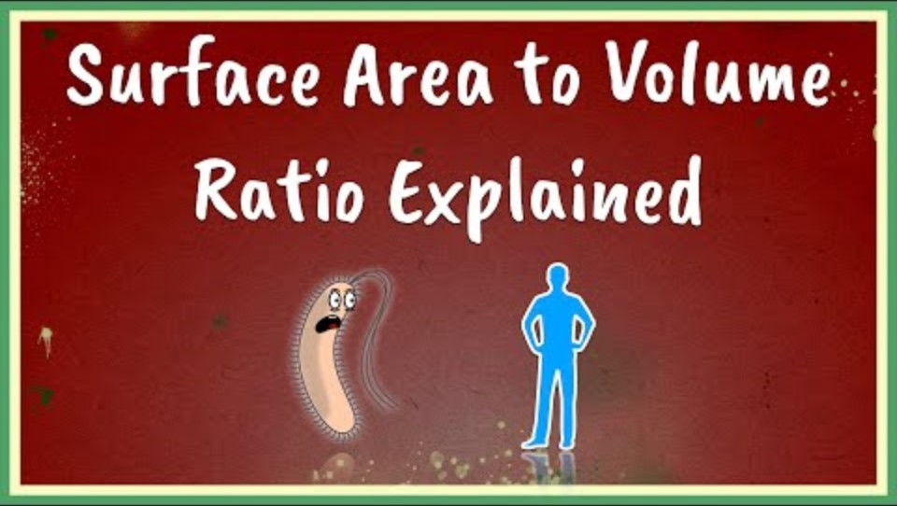
Surface area to volume
The larger the surface area the faster the diffusion

Slide 7
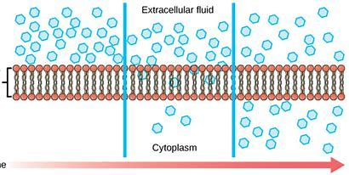
Concentration gradient
is the difference in concentration that brings about diffusion (between the extracellular fluid and the cytoplasm)
The greater the difference in concentration, the faster the rate of diffusion.
Eventually, the concentrations will reach equilibrium.

Slide 8
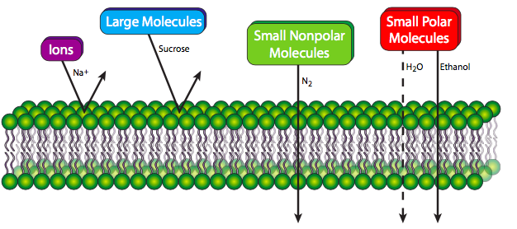
Nature of the substance
Physical nature, eg size of molecule
Chemical nature, eg polarity or charge of molecule

Slide 9
Task 1: Investigation of Osmosis and Diffusion
Conditions
Plan investigation Wed Week 2 (library) submit by Mon Week 3 (15 marks)
Conduct investigation, two class periods Tues, Wed Week 3
Report and write up completed in class Fri Week 3 (40 marks)
Task weighting
10% of the school mark for this pair of units

Slide 10
Success Criteria
Define concentration gradient
List factors affecting exchange across membranes
Give examples of substances transported by simple diffusion, facilitated diffusion, osmosis, active transport and vesicular transport

